Slide 1
Brand Attributes
QUALITY | RELIABILITY | LUXURY LIFESTYLE
TASTY | CONVENIENT | SERVICE (NESPRESSO CLUB)
PREMIUM PRICING | EXCLUSIVE
Notes:
Nespresso offers the high-quality product, continues to test and selects the highest grade of raw material and through the Nespresso AAA Sustainability
Quality Program to produce the highest quality drinks and special capsule flavors. All these can enhance the reliability for the members and the premium price can be applied for the unique product.
Nespresso is providing convenience and easy way for members to place order online and deliver on time. Nespresso club will offering exclusive and customized service to Nespresso members. Nespresso shop and website decorated neat, stylish and elegance that create atmosphere of luxury lifestyle for members.
Herbal Tea Capsule rising market of herbal tea market, we would like to develop new product -herbal tea capsule for Nespresso base on premium quality and reliable delivery. Same as current attributes more stylish, elegance and luxury lifestyle, it will be one of healthier and alternative to tea.

Slide 2
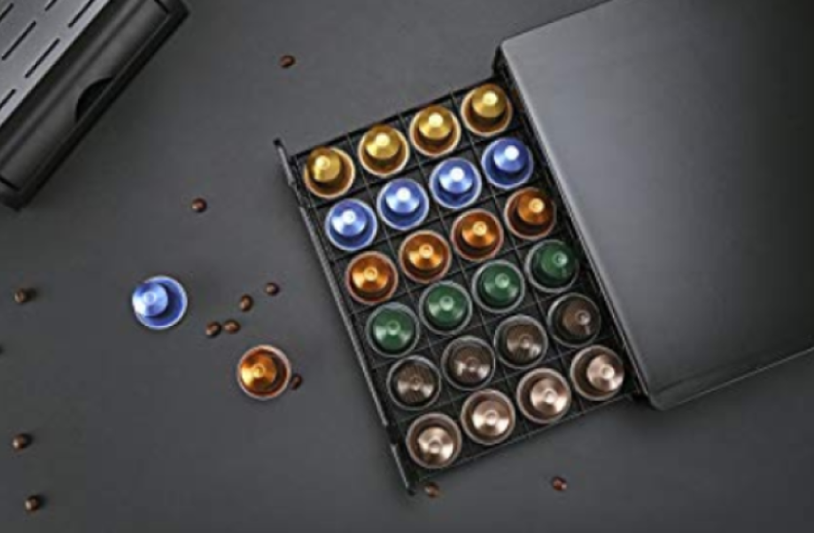
Herbal Tea Capsule
Quality
Reliability
Stylish, Elegant, Health
Luxury Lifestyle, Alternative option to tea
(amazon.fr, 2018)

Slide 3
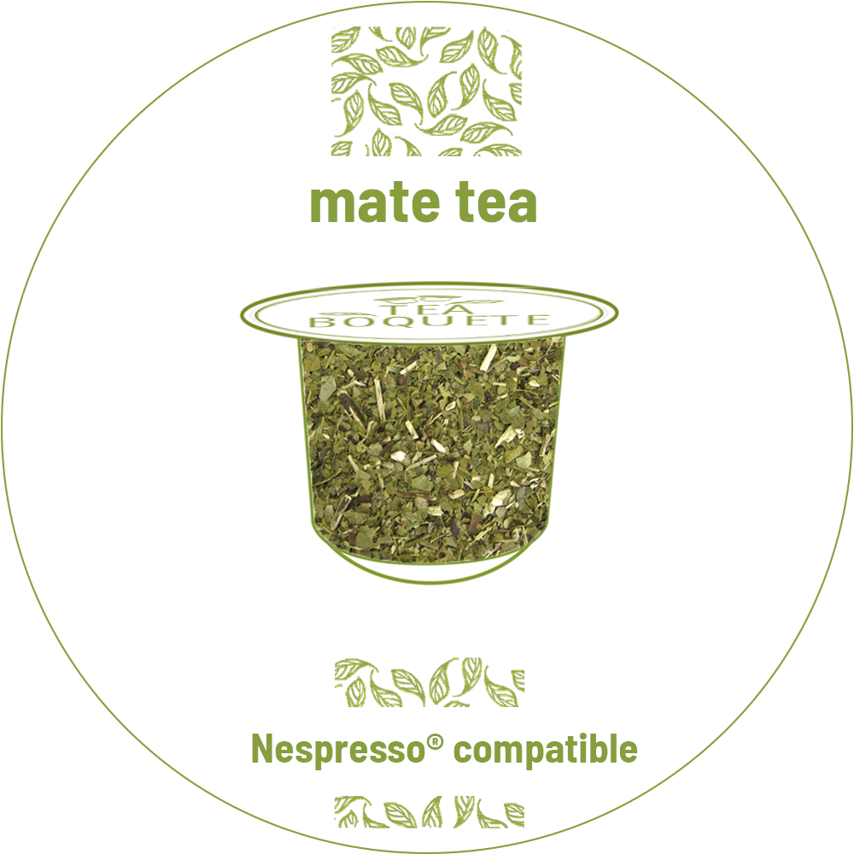
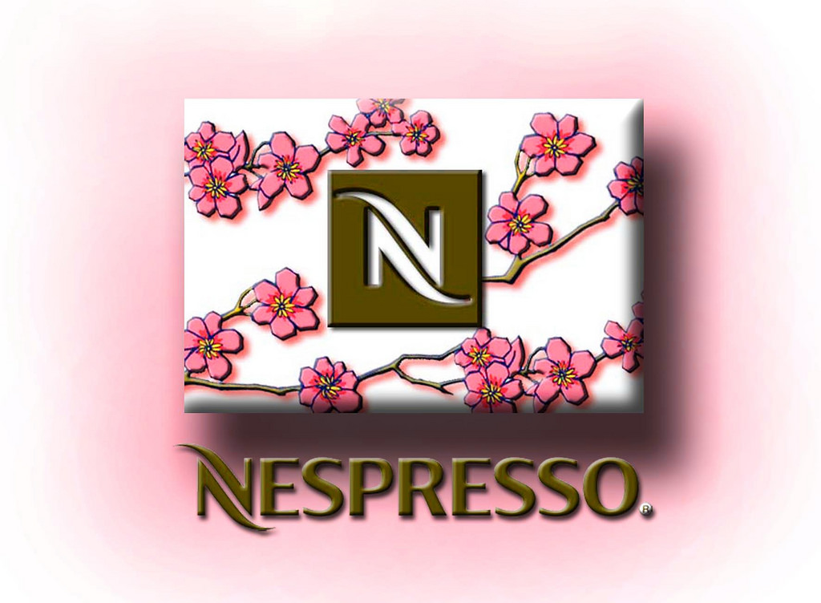
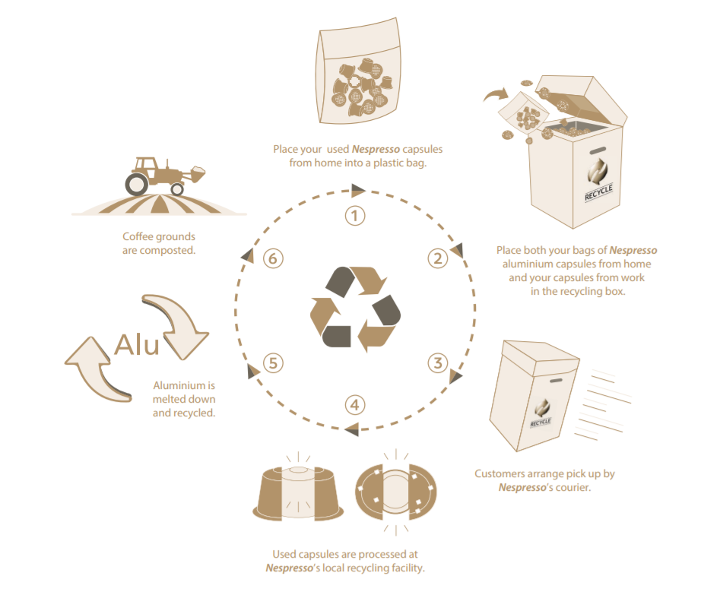
Current Strategies
Innovation
Luxury –like experience
Product consistency (Quality + Distribution channel)
Brand Protection
Sustainability
Notes:
Nespresso take the unusual step of innovating around the concept of single-serve coffee capsules in order to compete the traditional habit of coffee.
This innovation-driven model differentiated itself from others by taking an unusual step of using and applying scientific knowledge and evidence to enhance a product's value. While herbal tea is a new field for Nespresso to enhance, therefore this product is fit to their current strategy as they make coffee into luxury-like experience.
With the existing strategy of Nespresso. “Outside Home Tea” offering home-like comfort in the exclusive boutiques. Customers could enjoy their own Decaffined Herbal Tea Capsules using the Nespresso Machine everywhere e.g. club houses or private offices. It perceived as a luxury amenity to customer, also we can create brand image by using celebrities' brand equity such that customer can feel luxury-like experience while drinking decaffe herbal tea.
Nespresso’s business model is linked around a unique market position, product consistency and unique value creation architecture. Nespresso innovated around its product and distribution channels. The capsule machine is a value-generating complementary product to gain high margins come from the sale of capsules. The revenue logic is the cross-selling of coffee accessories. The variety of capsules that suited coffee drinkers taste that is sold through channels that allow close proximity between Nespresso and its customers. Therefore we can promote tea capsules sold online through the Nespresso Club in order to create long-lasting consumer relationship
Nespresso’s sustainability strategy helps farmers secure their livelihood such that ensure the quality of the production. To this point, we consider as planting tea or coffee bean have no contradiction, so that promoting tea capsule also fit into the existing strategy of the company.

Slide 4
1st step - Segmentation
Segmentation
Demographic (Gender, income, etc)
Psychographic (Lifestyle, values, etc)
Geographic (Nations, States, etc)
Behavioral (Benefits, loyalty status, etc)
(Kotler, Keller, Brady, Goodman, & Hansen; 2016)
Selected Segmentation:
1st Demographic: Executives- professional in herbal tea market
2nd Behavioral: Benefits and loyal status
Water
Notes:
According to the market research, there are rising consumer demand for herbal tea coupled with growing health awareness among consumers are likely to drive the market for heathy beverage including the decaffeinated market.
In the past year, there was 5% growth for Asia tea market, assuming there will be continuous growth for coming years. So, there is potential market on herbal tea.
Now, I’ll determine the STP for the herbal tea market.
For the first step to branding, segmentation, which divided by 4 characteristics that are demographic, such as gender, income, etc, then, Behavioral such as benefits, loyalty status, etc. And the third one is psychographic which are lifestyle, values. The last one is geographic are nations, states, etc.
For our new product, we selected demographic and behavioral for herbal market. Firstly, middle and high income executives and professional in herbal tea market based on demographic, as they much easy to access the coffee machine and willing to luxury product.
Since the new product can be offered the benefits such as healthy and relax.
For the loyalty status, once they build the trust, they will be a strong loyalty for the brand, that can be maintained a long term relationship that consist with our strategy.

Slide 5
2nd step – Targeting
Theory
Balancing segment opportunities against available resources (Dibb & Simkin, 2008).
Capable of assessment on measurable, substantial, accessible, differentiable, actionable (Kotler & Keller, 2016).
Selected targeting
Middle to high income female executives professionals (Niche market size)
Selective specialization for Nespresso
Attract target customer by achieve their needs and benefits (work-life balanced)
Notes:
After that, I would like to define the second step of branding, targeting. That mean, define as process involves balancing the attractiveness of segment opportunities and the organization‘s capabilities.
Targeting is capable of of assessment on measurable, substantial, accessible, differentiable, actionable.
Generally, professional women tends to seek more work life balanced as most of their times are occupied by work and some even home. They are also health and appearance conscious and interested to things that are beneficial to their health and skins.
Our selected target is niche market that focus on female group of middle to high income executives professionals.
Since coffee is Nespresso’s main business unit currently, new product line is created as selective specialization to expand market by appropriate and specific product.

Slide 6
2nd step – Targeting
Target Assessment by 5 criteria (Herbal Tea Market)
Measurable: size of segment
Substantial: profitable
Accessible: Reachable and servable
Differentiable: Responsiveness
Actionable: Effective plan to attractable and servable
(Kotler & Keller, 2016).
Notes:
So, how to assess target for herbal tea market?
It can be accessed by 5 criteria that are measurable to elevate the size of segment which is niche market.
Secondly, substantial as our target market, female professionals are willing to try and purchase the products which fit their needs. That can extend and maintain market life style in growth and maturity stage. However, the profit return may be much slower due to the niche market size.
Regarding to accessible, Nespresso is not the leader of tea industry, and it may need more time to reach the target group.
According to the market research, there is a finding of female much more prefer to taste fresh and light drinks. So our unique product is appropriate to the target group by differentiated quality and ingredients.
The last one is actionable, we suggest to create a customized new product launch promotion plan which based on actual scenario.

Slide 7
Customization is the core concept of Nespresso. It delivers consumers individual ’freshly-ground coffee and tea’ in various tastes.
3rd step - Positioning
Theory
Design company’s market offering and image in the mind of the target market (Ries & Trout, 2000).
Fulfill consumer’s needs and expectation.
Positioning: brand extension
Positioning Map
High Quality
Competitive Environment / Competitor | Benefits | Value
- Coffee makers and de-caffeine drink makers - Competes with fresh tea and tea bag market. | - Convenience Functional Alternative choice other than coffee | High-quality Luxurious Symbolic (noble & elegance) Experiential (VIP service)
Nespresso
Keurig
Tassimo
Expensive
Nescafe
Cheap
Low Quality
Notes:
Here, I would like to define the third step of branding, positioning.
Positioning is the act of designing the company’s market offering and image to occupy a distinctive place in the minds of the target market. And, fulfilling consumer’s needs and expectation achieve competitive advantages.
According to brand development, brand extension is selected for product category which is a new product line with existing brand name.
Positioning mapping is review the positioning in the market.
Nespresso is revealed as high quality and expensive. And the Nescafe which is another line from Nestle ́ is relatively in low-quality and low-price brand.
Our competitors in high end market are Keurig and Tassimo.
In this case, there are three elements of a brand’s positioning; these are: competitive environment and competitor, benefits, values. And you may see this table for our brand positioning.
The basic idea of the Nespresso concept is customization. It delivers consumers individual ’freshly-ground coffee and tea’ in various tastes.
Consumers are able to prepare their capsule drink based on their personal preferences with delicate crema, full-bodied taste and aroma. Therefore, the unique positioning of Nespresso is the confluence of wide variety of choices and a personal herbal tea experience coupled with convenience (Matzler et al., 2013).
So that, our product suits perfectly the customers needs and wants.
----------------------------
1. Which basic customer need are we trying to fulfill?
2. How can we establish and retain a unique position in our customers’ minds?

Slide 8
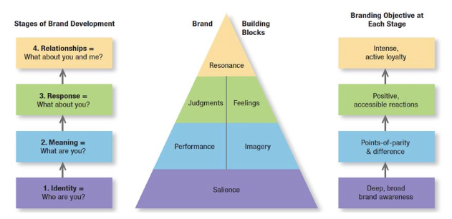
Customer-based Brand equity
(Keller, 2012)
Notes:
In order to create an unique position and image in our customer’s mind. We need to build, maintain and strengthen our brand equity and add value to the brand from a customer’s perspective. In order to build a strong brand, we must shape how customers think and feel about our product. We have to build the right type of experience and meanings to our brand, so that our customers have the specific, positive thoughts, feelings, beliefs, and perceptions about it. That’s why brand equity should be customer-based according to Keller..
There are four key levels to develop a successful brand, which are
Brand identity
Brand meaning
Brand responses
Brand relationships
It basically means for our customer to learn the true and understated meanings and value of our products, recognize it as part of their daily life and eventually can’t live without it.
A strong brand equity not only can create customer interest and loyalty, and can be an organization most valuable strategy asset and help to differentiate your product with your competitors

Slide 9
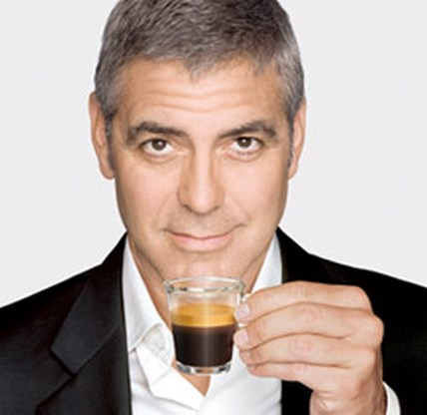
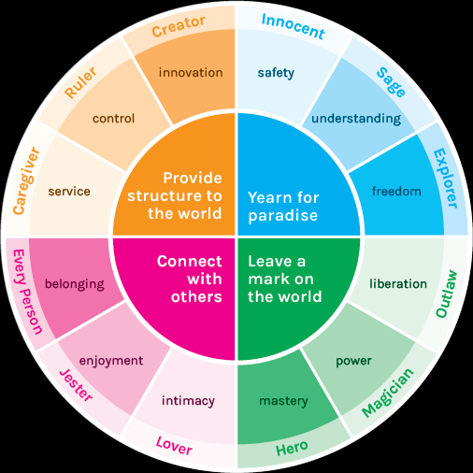

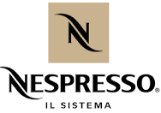
Brand Archetypes
Through storytelling……..
Notes:
It is important that you build the right and relevant image for your brand. There are 12 types of brand images or we call it the Brand Archetypes in the academic field. It is the brand personality that we want our customers to perceive. The brand archetypes of Nespresso is more towards the Lover and Jester sides as it attempts to create a close and intimate person to person connections. It aims to connect people especially our club members which are coffee lovers as one community. Nespresso uses celebrity George Clooney as the face of the brand and in fact he was actually chosen and voted by the Nespreosso Club members. It was a very successful marketing scheme, as it tells the company how their brand was perceived by their customers or how their customers want the brand to be. And when you think of George Clonney, he does represents the smart, professional, fun loving and luxury types which aligns to the nespresso brand.
Building on the strong brand equity and their infamous brand archetypes, we also need to be consistent with the existing strategy. And the best way is through storytelling by one of their commercials.

Slide 10
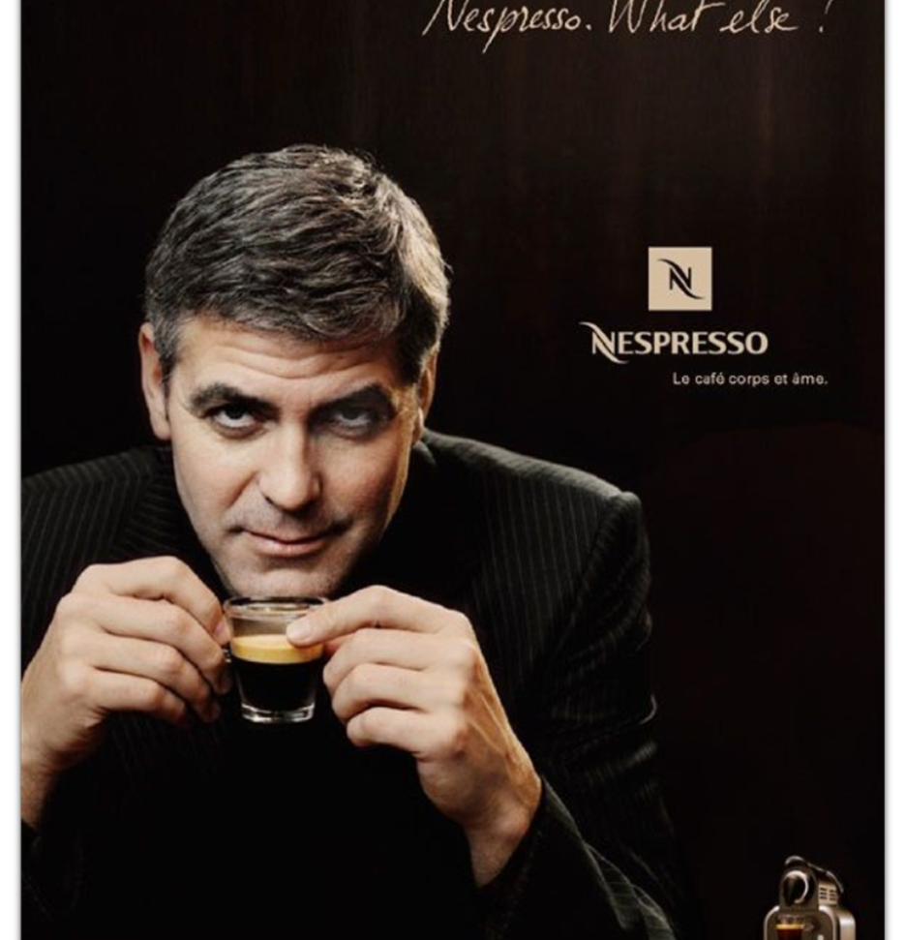

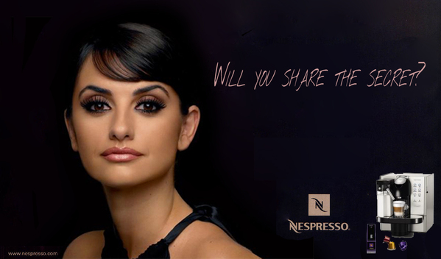
Is George
a true
Mr. De-caffeinato?
So what
else
can be
for her?
Notes:
So the idea is ….is Geroge really is Mr. de-caffeinato? Our story tells us that the de-caffeine coffee was actually his wife for who is a non-caffeine drinker. She is a sophisticated professional women who is very self conscious. She doesn’t drink coffee however, she enjoy the experience of having a cup of nice quality drink by a push of a button. So apart from coffee, what else can be for her?
Our Herbal tea capsule is the answer.
There are many reasons we chose her as the ambassador for our new product beside her positive image and certain level of popularity in both Hong Kong and international levels, such as professional women image and characteristic, elegance, determined and self conscious which matches perfectly to our target market.

Slide 11
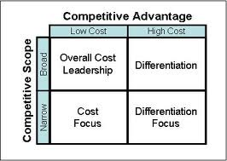
Competitive Advantages (Differentiation Focus by Porter’s Generic Strategy)
Strong Brand Equity – Nespresso
  Premium product for consumers and Club Members
  Customer experiences with Trust
Unique service offering
  Membership scheme (Exiting special club) free tasting Nespresso
  drinks at retail shop
  Exclusive distribution channel (in house control only buy on retail or online shop
  Drink delivery E-com/ online selling
  (Guarantee 48-hour delivery maximum. Some countries propose
  24-hour delivery and same-day delivery)
Convenience & straightforward designed capsule and machine
  Nespresso capsule and the Nespresso machine
  – is designed to work as one to deliver the perfect cup
  Only push one button to enjoy
  Technology location to enhance product value
  Scientific innovation across the board is key to end-to-end value. (Nespresso’s strategic and operation ex…. (2011))
Notes:
Competitive Advantages & Potentially differentiate
But actually, our brand name and strategies bring potentially competitive advantages.
First, I think no one don’t know this brand here right? Nespresso ~ the name contains commitment to our consumers and stockholder. Only provide premium coffee in past and Herbal Tea in the future. Also, if you interested this brand and its production, you will know that we provide free tasting in our retail shops, our staff will bring you manual and clear explain the different of our products. You can also find our details information and buying your interest easily in our e-com system, through this channel, people will not difficult to understand our new product. Do what we always do for our product, plus service plus information.
lifestyle product
Business Design: An Interview with Adrian Slywotzky
Euchner, Jim
Research Technology Management, Jan/Feb 2015, Vol.58(1), pp.12-18 [Peer Reviewed Journal]

Slide 12
Further action for branding strategy
MORE ACTION.
Built a unique value creation & Equal Price Strategy as Coffee product-Increase the product perceived value for brand extension product - Herbal Tea
Advertise luxury image with Smart – Superwomen concept
Machine design
Female
Small size portable
Color (Female, Elegant, Light color)
  Specific the Product consistency (taste/ quality) and Fresh
EXPLORING SUSTAINABLE QUALITY & RECYCLING PROGRAM
  Build more recycle capsules station
  Work with farmer with farmer certified AAA and strategy Rainforest Alliance Certified
Notes:
Potentially differentiate
To be continue…
Consumers in the luxury goods market show a strong tendency to buy high-priced products, as this new production positioning not focus on Broad class consumers, and the equal price strategy can build up the product perceived value . and have the propensity to pay a price premium if they perceive an additional, individual value. Therefore, brand strategies for luxury goods focus on differentiation in order to create a completely new value, or to add further features that are useful for promoting the brand (Matzler et al.,2013).
High quality is a concept that is not so precise. If the original specifications are present in a product, it can be said that high quality is present. In most of the cases the concept
is more related to price of the product that is traded than the real specifications of the product (Prajogo et al., 2008).
Nespresso’s strategic and operational excellence: a review and logistical implications
Cimon, Yan ; Poulin, Diane
Supply Chain Forum: An International Journal, 02 January 2017, Vol.18(1), p.30-35 [Peer Reviewed Journal]
Business model innovation: coffee triumphs for Nespresso
Matzler, Kurt ; Bailom, Franz ; Friedrich Von Den Eichen, Stephan ; Kohler, Thomas
Journal of Business Strategy, 29 March 2013, Vol.34(2), pp.30-37 [Peer Reviewed Journal]
COMPETITIVE STRATEGY
Porter, Michael E
Measuring Business Excellence, 01 February 1997, Vol.1(2), pp.12-17 [Peer Reviewed Journal]

Slide 13
Website:
- Amazon.fr .(2018). amazon.fr .Retrieved from https://www.amazon.fr/
- Nespresso. (2018). Nespresso. Retrieved from https://www.nespresso.com/hk/
- NCA. (2017). NCA 2017 & 2016 US market Coffee Drinking Trends Report. Retrieved from http://www.ncausa.org
- Allied Market Research. (2018). Tea Market Expected to Reach $67,751 Million, Globally, by 2023. [online]
Available at: https://www.alliedmarketresearch.com/press-release/tea-market.html\
-Journals:
- Hassan, S. S., & Craft, S. (2012). Examining world market segmentation and brand positioning strategies. Journal of Consumer Marketing, 29(5), 344-355.
- Keller, K.L. (2012). Strategic Brand Management, 4th Edition. City, State: Prentice Hall.
- Markides, C., & Oyon, D. (2000). Changing the strategy at Nespresso: An interview with former CEO
Jean-Paul Gaillard. European Management Journal, 18(3), 296-301.
References

Slide 14
Journals:
- Matzler, K., Bailom, F., von den Eichen, S. F., & Kohler, T. (2013). Business model innovation: coffee triumphs for
Nespresso. Journal of Business Strategy, 34(2), 30-37.
- Matzler, K., Bailom, F., Friedrich von den Eichen, S., & Kohler, T. (2013). Business model innovation: coffee triumphs for Nespresso. Journal of Business Strategy, 34(2), 30-37.
- Markides, C., & Oyon, D. (2000) Changing the strategy at Nespresso: An interview with former CEO Jean-Paul Gaillard. European Management Journal, 18(3), 296-301.
Book:
- A. Ries and J. trout (2000) Positioning: The Battle for Your Mind,
20th anniversary edition, new York: mcgraw-hill; see also evaluating the effectiveness of brand-positioning strategies from a consumer perspective, European Journal of Marketing, 2010, 44(11/12), 1763–86; J. trout (2012) positioning myopia, Marketing News, 15 march, 46(3), 34.
- Dibb, S., & Simkin, L. (2008). Market Segmentation Success : Making It Happen! (pp.1-26). Richmonfd Hill, Canada: Routledge
- Kotler, P., Keller, K. L., Brady, M., Goodman, M & Hansen, T. (2016). Marketing management (pp327-377). Harlow, Essex, England : Pearso.
References (Continus)

